Slide 1
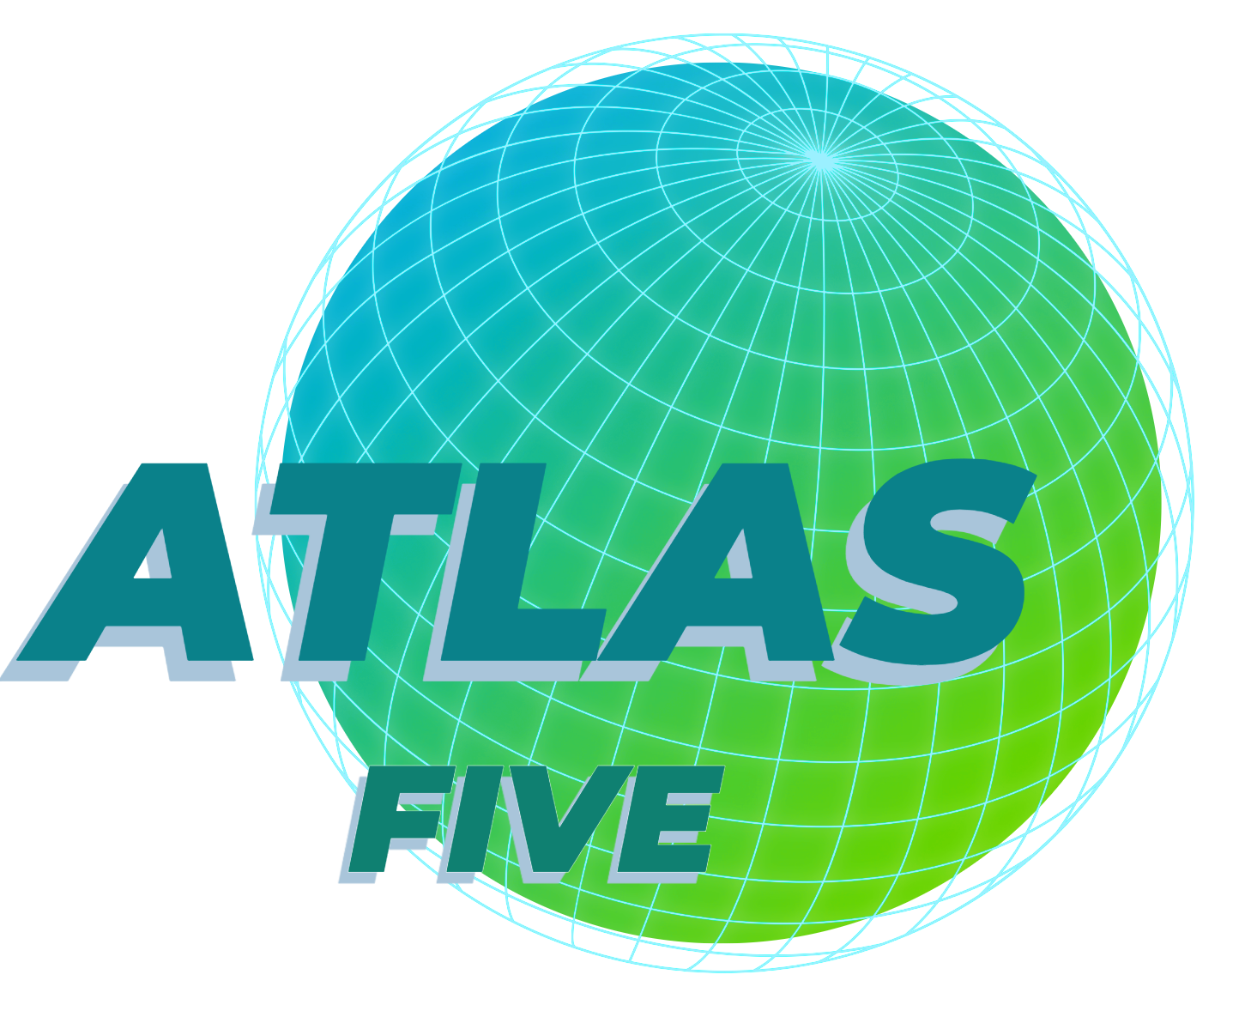

Slide 2
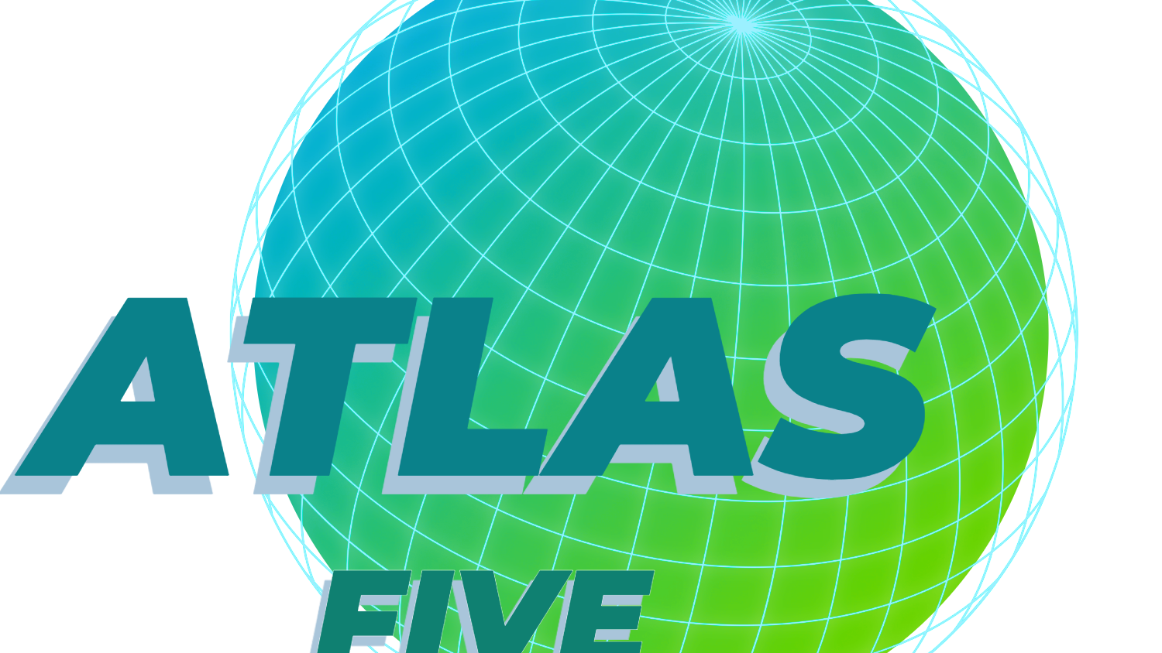

Slide 3
Mission Statement
“Creating solutions for businesses with
an accessible and simple approach"
The idea being, our goal is to help people who are not well versed with software design to harness its power.

Slide 4
Group of Programmers
Web Designers
Who Are We?
Database Technicians

Slide 5
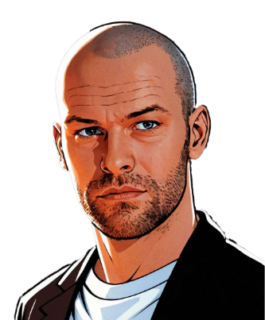
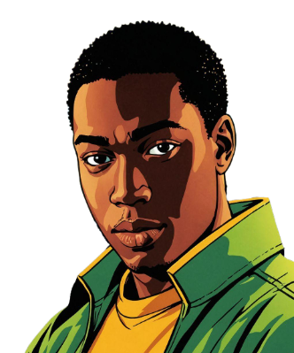
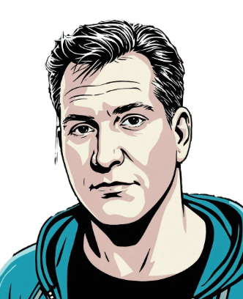
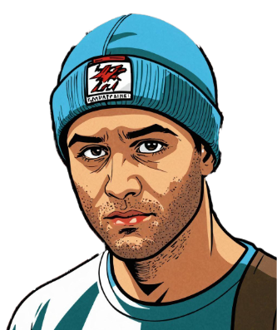
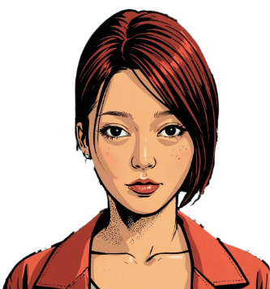
Frazer Kennedy
Originally from Nigeria currently studying computer programming and analysis at Niagara College Canada,
Work experience:
3 years of Customer Service Representative
2 years as a Sales Analyst
Proficiency in programming (CSS, SQL, HTML, JavaScript)
Excellent communication and Sales Reports
Aspiring to become a Full Stack Developer and System Analyst
Originally from Seoul, South Korea , graduated with a Bachelor’s degree in mathematics from Brock University.
Work Experience Includes 2 years of working in an accounting team in Toronto.
Strong analytical and problem-solving abilities
Proficiency in programming languages (e.g R, Python, SQL)
Aspiring to become a data scientist.
Originally from Thorold, now living in St. Catherines
Work Experience
Worked as an assistant and website maintainer at a news outlet 2 years
Also worked as a youth accessibility leader for 2years
Enrolled at Niagara College in the Computer Programming and Analysis Course.
Skills: (JavaScript, React, Python)
Future goals: Becoming a full stack developer
Previous career as a fine dinning chef in Toronto for 10 years.
U of T Web development bootcamp grad.
Self taught solo indie game developer with Unity
Recently employed by Niagara College's Research and Innovation department
Goal is to become a full stack software developer.
Originally, from St. Cathartines, Ontario, I now residing in the City of Welland.
12+ years in computer technology
14 years in Manufacturing as a Quality Assurance Technician, Supervisor and Project Coordinator.
Aspiring to complete my diploma in Computer Programming and Analysis through part-time studies.

Slide 6
Frazer Kennedy
Jeff Holditch
Zach Leitch
Jennie Jeong
Stefan Nzene
Previous career as a fine dinning chef in Toronto for 10 years.
U of T Web development bootcamp grad.
Self taught solo indie game developer with Unity
Recently employed by Niagara College's Research and Innovation department
Goal is to become a full stack software developer.
Originally, from St. Cathartines, Ontario, now residing in the City of Welland.
12+ years in computer technology
14 years in Manufacturing as a Quality Assurance Technician, Supervisor and Project Coordinator.
Aspiring to complete my diploma in Computer Programming and Analysis through part-time studies.
Originally from Thorold, now living in St. Catherines
Work Experience
Worked as an assistant and website maintainer at a news outlet 2 years
Also worked as a youth accessibility leader for 2years
Enrolled at Niagara College in the Computer Programming and Analysis Course.
Skills: (JavaScript, React, Python)
Future goals: Becoming a full stack developer
Originally from Seoul, South Korea , graduated with a Bachelor’s degree in mathematics from Brock University.
Work Experience Includes 2 years of working in an accounting team in Toronto.
Strong analytical and problem-solving abilities
Proficiency in programming languages (e.g R, Python, SQL)
Aspiring to become a data scientist.
Originally from Nigeria currently studying computer programming and analysis at Niagara College Canada,
Work experience:
3 years of Customer Service Representative
2 years as a Sales Analyst
Proficiency in programming (CSS, SQL, HTML, JavaScript)
Excellent communication and Sales Reports
Aspiring to become a Full Stack Developer and System Analyst

Slide 7
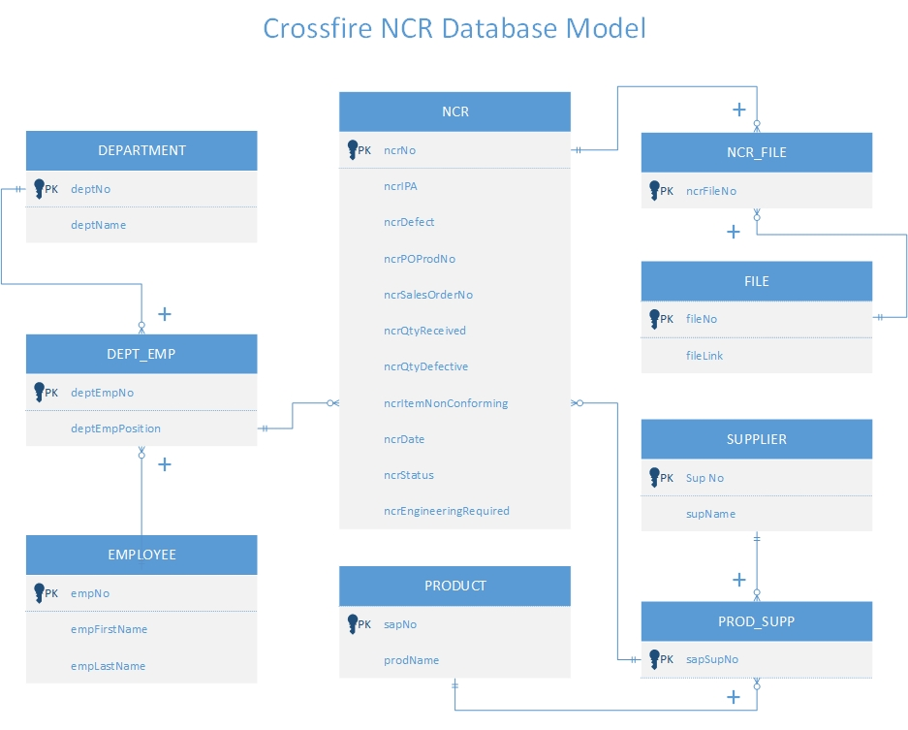

Slide 8
Some Examples of NCR products

Slide 9

COMPETITION AND WHAT THEY OFFER
Highlight info:
· Upload images/videos of problem
· Customizable forms
· Kanban collaboration system
· Supports all devices (mobile, web, etc.)
· $45/user/month

Slide 10

COMPETITION AND WHAT THEY OFFER
Highlight info:
Upload images/videos of problem
Customizable forms
Supports all devices
Requires more setup than our dedicated app would, due to generalization of features and having to build it up yourself.
Product is not DEDICATED to product conformity, so the features are more generic, so there will be a lot of unused features the client will end up paying for
Custom enterprise pricing.

Slide 11

COMPETITION AND WHAT THEY OFFER
Highlight info:
Useful employee-based form options for workflow.
Though it provides many form field options, it lacks the option to attach images/videos which our client values highly
Bloated feature list, client will most likely end up paying for unused features.
Starting price of $30/user/month

Slide 12
What we have over the competition:
Custom built for the client
A strong focus on collaborative design
Lightweight and straightforward design

Slide 13
The Vision Behind Atlas Five: Our Name and Goals as a Team
When you think of the world “Atlas”, you think of global , maps , the world , so we decided as team to call our company Atlas Five to represents our expertise in creating websites that works smoothly across the globe.
Our Goal as a team is to continuously improve our respective skills and learn from each other to better the other skills we are lacking as Programmers

Slide 14
Crossfire
Our client, Crossfire, has a quality control system that includes regular product inspections. The core of their quality control system is their non-conformity reports. Atlas5 will simplify their current non-conformity process by designing and building a new NCR application.

Slide 15
Crossfire
Key client needs for our application:
A Non-conformance reporting application to streamline their currently convoluted report creation workflow.
Emphasis on collaboration between different departments.
The ability to easily document and prove the non-conformance by attaching images and videos to reports
Converting these reports into PDF format so the supplier can see and take corrective action.

Slide 16
we came up with our company name through me asking Stefan about a book he was reading about he said the title was Atlas 6 and i said well why don't we call us Atlas 5 cause there's 5 of us. not glamorous but it got us a name.
for talents I bring, I'm a full stack developer with project management experience I can fit myself into what ever job needs to be worked on at any point.
we hope to tackle I believe the goal is to work on areas of personal weakness while helping build up others in areas where we are strong. A nod to the ideology of a machine being greater than the sum of its parts.
For a project name the examples he gave were quite simple, something like AtlasNC (Atlas Non-Conformance) or something simple that describes the functionality of our project.
In terms of skills, I have worked on a lot of personal full stack projects, mainly web applications, I mostly do javascript related programming in my free time so thats what I'm most comfortable with, but I have a good amount of experience on all the stuff we'd be doing in throughout this project.

